Slide 1

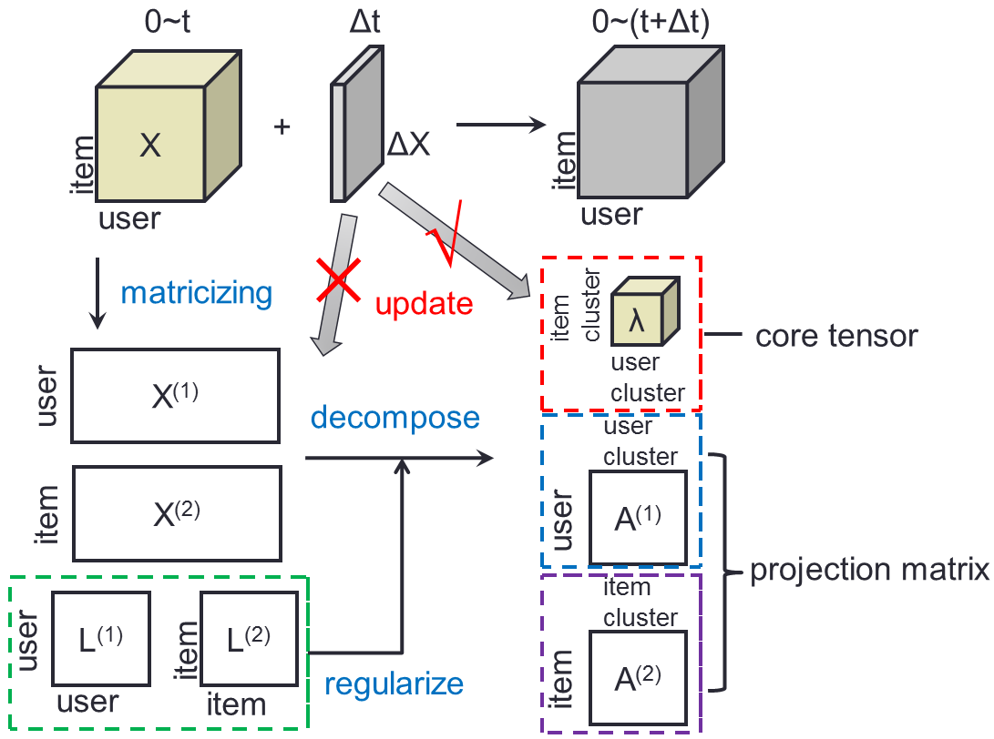







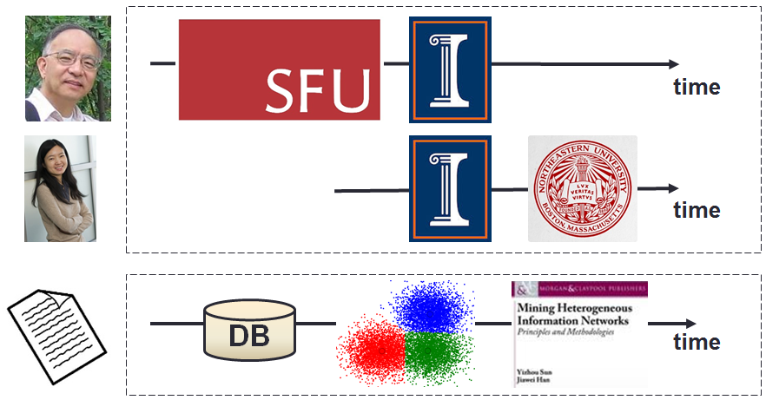
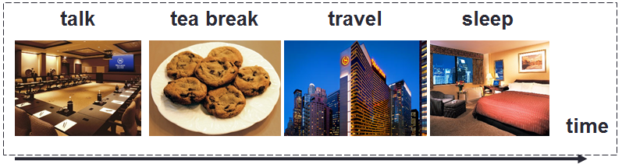
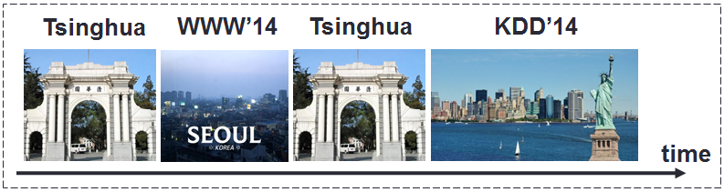
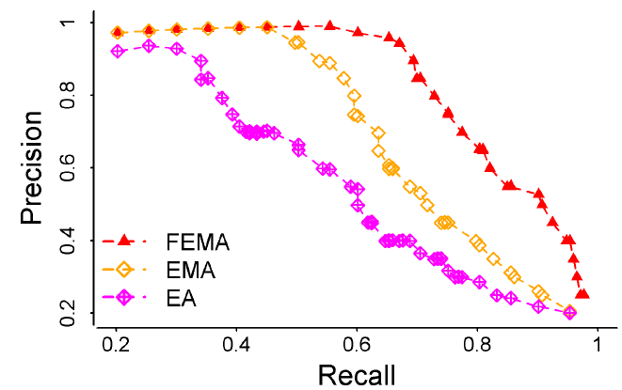
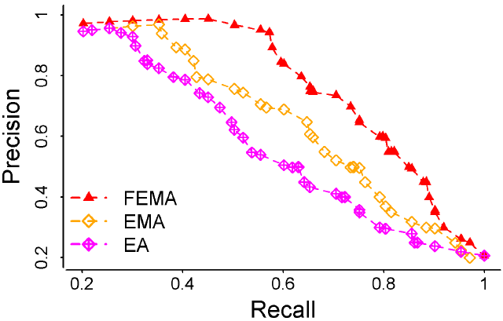
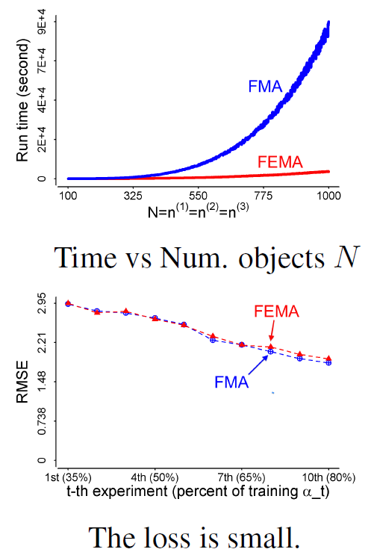
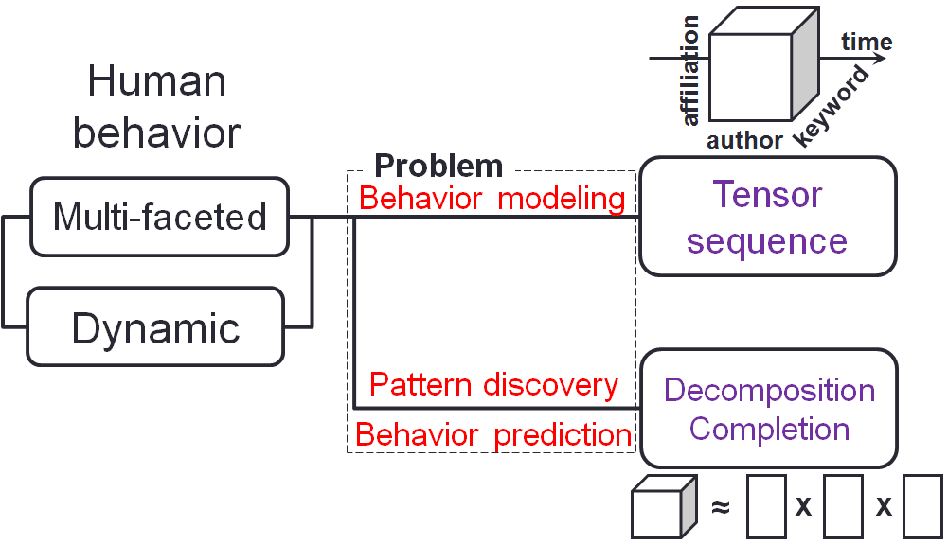
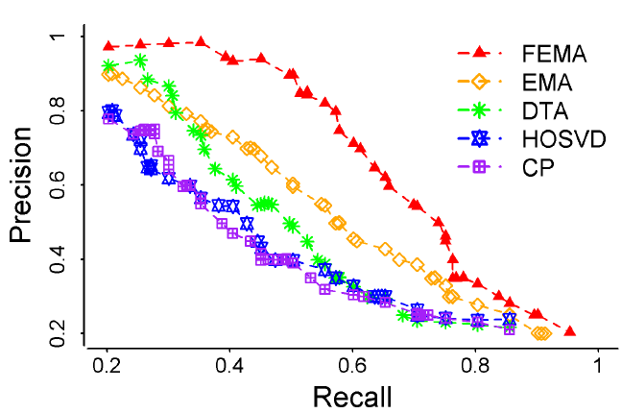
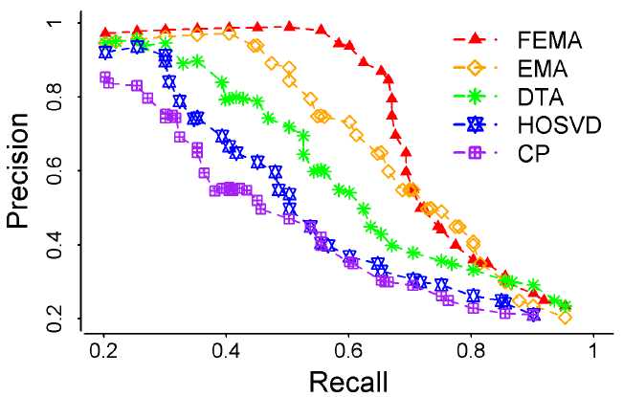
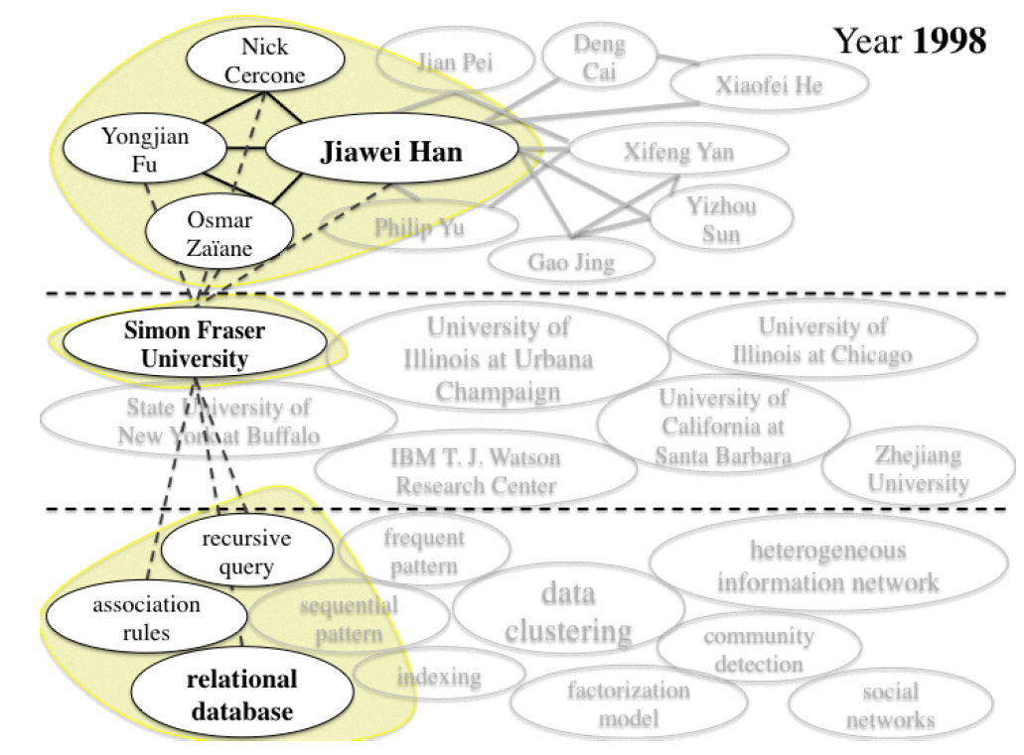
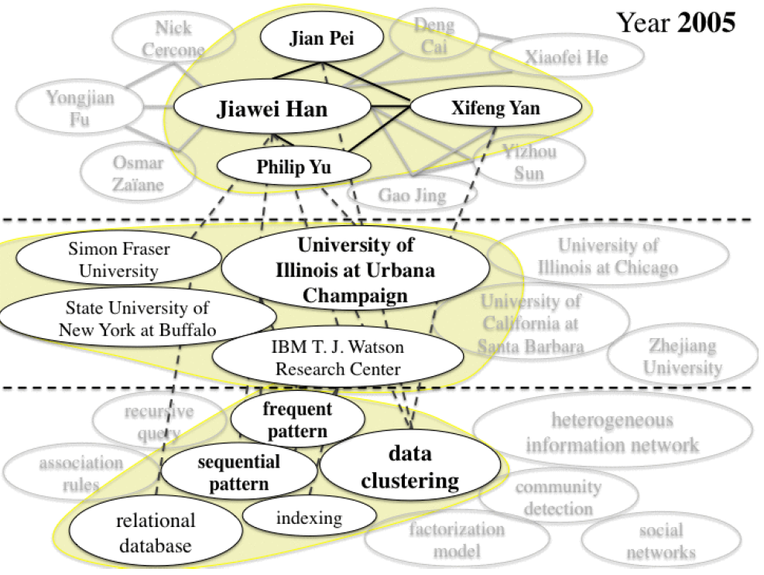
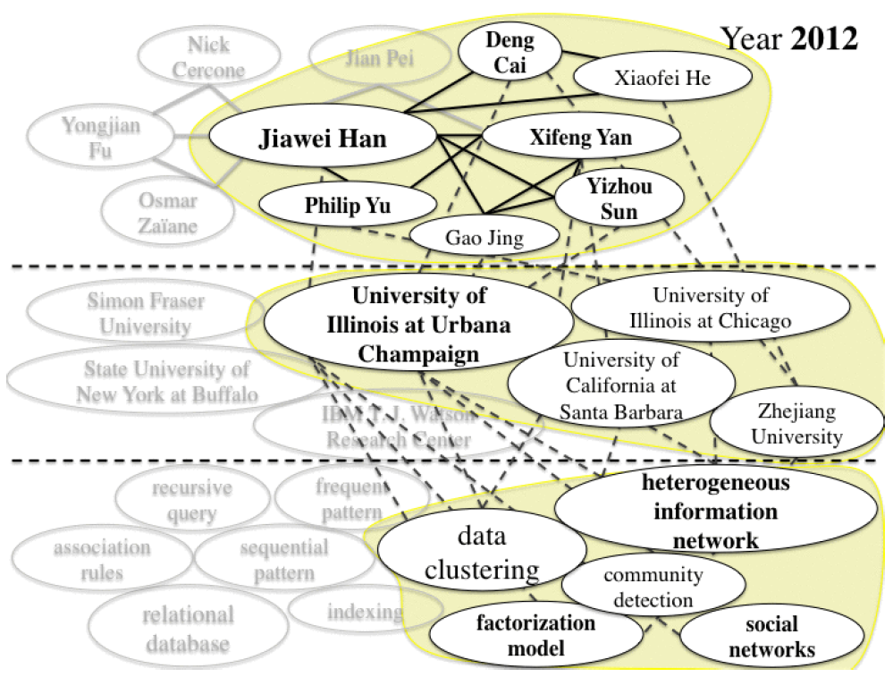
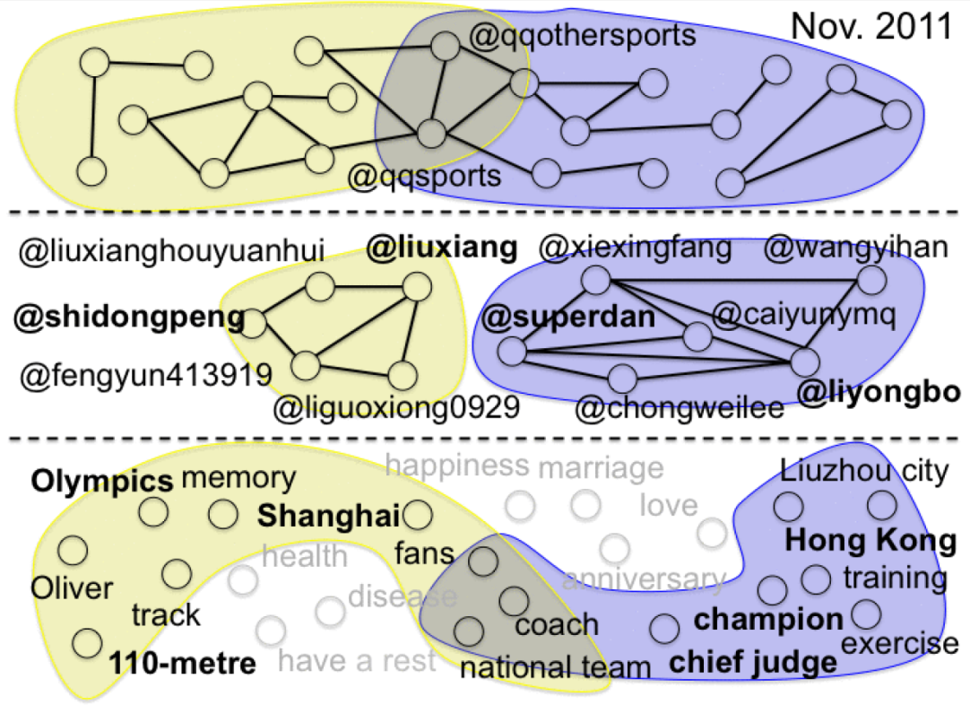
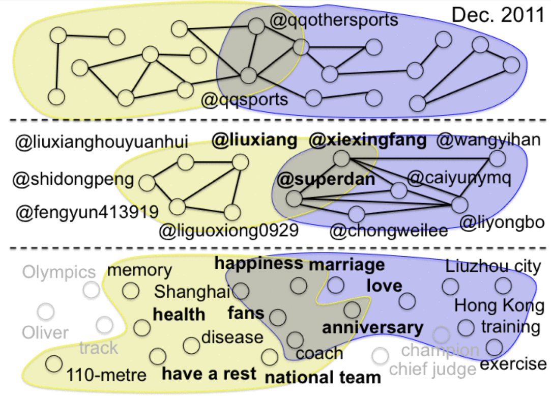
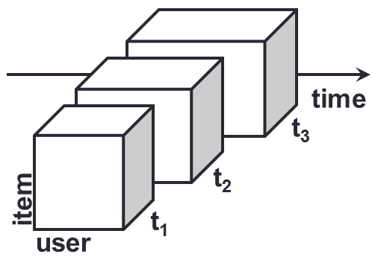
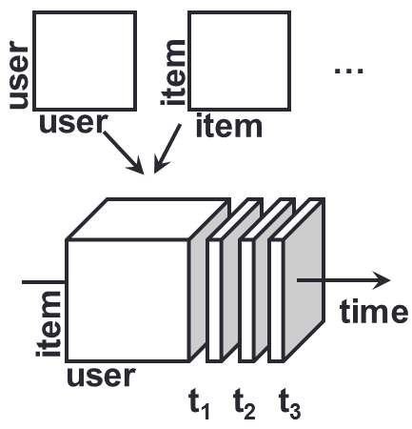

FEMA: Flexible Evolutionary Multi-faceted Analysis for Dynamic Behavior Pattern Discovery Meng Jiang¹, Peng Cui¹, Fei Wang², Xinran Xu¹, Wenwu Zhu¹, Shiqiang Yang¹ ¹ Department of Computer Science and Technology, Tsinghua University, Beijing, China ² IBM T. J. Watson Research Center, Yorktown Heights, NY, USA
FEMA
Motivation and Goals
Framework and Algorithm
Modeling
How to formulate human behavior?
Pattern discovery
How to understand human behavior?
Prediction
What is the missing human behavior?
KDD’13
?
KDD’14
Given: Behavior data sequence
Find: A behavior analysis framework that fast and best discovers behavior patterns
Goals:
G1. Model the human behavior
G2. Understand the hidden patterns
G3. Predict the missing behavior
Tensor Perturbation Theory
Human Behavior Modeling
Approximation Algorithm
Behavior: Multi-faceted information
Bound Guarantee
Behavior: Dynamic
Experiments
Leveraging Multi-faceted Info
Leveraging Flexible Regularizations
Efficiency & Loss
Microsoft Academic Search: Author, Affiliation, Keyword
Challenges and Solutions
C1: High Sparsity - high-order tensors
S1: Auxiliary knowledge from regularizations
C2: High Complexity - long sequence of tensors
S2: Update projection matrices with new coming data
Tencent Weibo: User-who-@, User-who-@ed, Word
Acknowledgement
Contact: Meng Jiang
<jm06@mails.tsinghua.edu.cn>

